Slide 1



Lecture-4
Fundamentals -II
Programming Fundamentals contd..
Kartik Mathur

Slide 2
Any doubts?

Slide 3

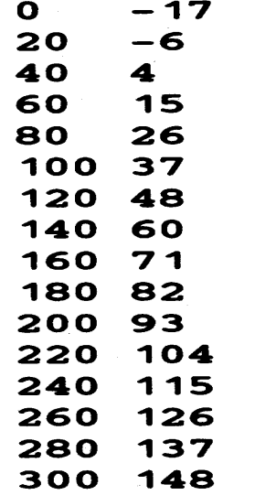

Warm up!
Write a program which takes initial value, final value and a step value and prints a table for Fahrenheit to Celsius using formula - C = (5/9)(F
– 32)
E.g: For initial 0, final 300 and step 20 output is

Slide 4
Warm up!
Write a program which takes and character input and check that whether a number is an Upper Case or a Lower Case.
A to Z – Upper Case
a to z- Lower Case

Slide 5
Square root of a given number?

Slide 6
Sizeof( ) operator ?
10

Slide 7
Constants
11
C++ has two types of constants
 Literals
i. Integer [ 212, 215u,0x4b,077, 30ul, 75L)
ii. Floating [3.14, 31459E-5]
iii. Boolean [ true, false]
iv. Character [ ‘a’, ‘\n’, ‘\t’, ‘\\’, ‘\’’ ]
v. String [ “Coding Blocks” ]
 Symbolic Constants
#define preprocessor(no space is occupied, not compiled, can’t be changed in main)
const keyword

Slide 8
Type conversion!
12
 Implicit – Based on the operator and operands
 Explicit – (new type) expression

Slide 9
Operators we have seen
13
 Unary [ +, - ]
 Arithmetic [ +, -, /, *, % ]
 Brackets [ () ]
 Assignment [ = ]
 Relational [ ==, !=, >, <, >=, <=]
 Logical Operators [ &&, ||, ! ]
PS - 1: Relational Operators and Logical Operators always Evaluate to 0 or 1
PS – 2: For logical evaluation any non-zero value is
true.
PS - 3: Evaluation of a logical expressions stops as soon as the final value is known.

Slide 10
Some more operators!
 Arithmetic – [ ++ , -- ]
 Bitwise Operators – [ &, | , ~, ^, <<, >>]
 Compound assignment operators –
[ +=, *=, /=, %=, &=, |=, ^=, <<=, >>= ]

Slide 11
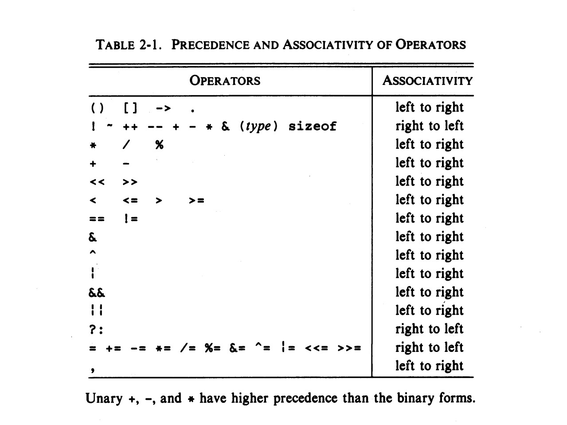
Precedence & Associativity

Slide 12
Another type of a loop!
16
for(initialization;condition;updation) {}

Slide 13
Lets convert some problems to use for
 Print all prime numbers between 2 to N
 Reverse a number
 Print the following p a t t e r n
1
0 1
1 0 1
0 1 0 1
1 0 1 0 1

Slide 14
To alter normal flow of a loop
 break;
continue;

Slide 15
Homework?
20
 Given an integer n, count number of bits s e t ( number of bits which are 1) in it.
 Given N,Print following pattern (FOR N = 5)
ABCDEEDCBA
ABCDDCBA ABCCBA ABBA
AA

Slide 16
Thank You!

